Slide 1
UECS1013 Introduction to Computer Organisation and Architecture
Lecture 2

Slide 2
Outline: Number System
  Conversion Between Number Systems
    Conversion from Decimal (Base 10) to other Bases
    Sum of Weights Technique
    Radix Divide and Multiply Technique
    Special Conversion Cases: Related Number Bases
  Manual Arithmetic in Different Number Bases
    Addition
    Multiplication
    Subtraction
    Division
  Computational Arithmetic
    Sign and Magnitude
    9’s and 10’s Decimal Complement
    1’s and 2’s Binary Complement

Slide 3
CONVERSION BETWEEN NUMBER SYSTEMS

Slide 4
Conversion from Decimal (Base 10) to Other Bases
There are two different methods to perform conversion from Decimal (Base 10) to other bases:
Method 1: Sum of Weights Technique
Method 2: Radix Divide and Multiply Technique
  Repeated division for integral part
  Repeated multiplication for fractional part

Slide 5
Sum of Weights
[Recap] Converting a number (base 8) to base 10
Converting from base 10 to another base
  Use the same method in reverse (not so simple)
  Method: Find the values at each position each with different weights such that the total will add up to the base 10 number that we are trying to convert
Number = 13754₈
Value → 1 3 7 5 4 ₈
Weight → 4096 512 64 8 1
Number = 4096 + 1536 + 448 + 40 + 4
= 6124₁₀

Slide 6
Sum of Weights
Integral Part
Step1: Start from the first position from the left with a weight smaller than the decimal number.
Step2: Divide the remainder (initially the integral part of the original number) by the current weight to generate the remainder and quotient.
Step3: Go to next position and repeat step 2 until the first integral digit.
The value at the quotient is our result
Fractional Part
Repeat step1 to step 3 but for fractional part
Position | 5 | 4 | 3 | 2 | 1 | 0 | -1 | -2
Weight (Base 2) | 32 | 16 | 8 | 4 | 2 | 1 | 0.50 | 0.25
Division
Quotient
Remainder
28.75₁₀
= 11100.11₂
12/8
0/2
0.75
0.25/0.25
28/16
4/4
0/1
/0.5
1
1
1
0
0
1
1
12
4
0
0
0
0.25
0

Slide 7
Sum of Weights
Example: Convert 6124₁₀ to Base 5
Position | 6 | 5 | 4 | 3 | 2 | 1 | 0
Weight (Base 5) | 15625 | 3125 | 625 | 125 | 25 | 5 | 1
Division |  | 6124/ 3125 | 2999/ 625 | 499/ 125 | 124/ 25 | 24/5 | 4/1
Quotient |  | 1 | 4 | 3 | 4 | 4 | 4
Remainder |  | 2999 | 499 | 124 | 24 | 4 | 0
6124₁₀ = 143,444₅

Slide 8
Sum of Weights
Example: Convert 3193₁₀ to binary
Position Weights Division Quotient Remainder
12 4096
11 2048 3193/2048 1 1145
10 1024 1145/1024 1 121
9 512 0
8 256 0
7 128 0
6 64 121/64 1 57
5 32 57/32 1 25
4 16 25/16 1 9
3 8 9/8 1 1
2 4 0 1
1 2 0 1
0 1 1/1 1 0
Answer: 3193₁₀ = 110001111001₂

Slide 9
Radix Divide and Multiply
Division-by-Base (Base 2 example)
For the integral part, write down a sequence of bits, determined by the following procedure, to the left of the radix point:
  Divide the number by 2.
  If the result in non-integral, write down a 1. Otherwise write down a 0.
  Retain the integral part of the result.
  If it is non-zero, go back to step 1 and keep writing to the left of the previously written sequence.

Slide 10
Radix Divide and Multiply
Multiplication By Base (Base 2 example)
For the fractional part, write down a sequence of bits, determined by the following procedure, to the right of the radix point:
  Multiply the number by 2.
  If the integral part of the result is 1, write down a 1. Otherwise write down a 0.
  Retain the fractional part of the result.
  If it is non-zero, go back to step 1 and keep writing to the right of the previously written sequence.

Slide 11
Radix Divide and Multiply
Example: Convert decimal number 28.625 into a binary number.
    28/2 = 14.0 → 0.
    14/2 = 7.0 → 00.
    7/2 = 3.5 → 100.
    3/2 = 1.5 → 1100.
    1/2 = 0.5 → 11100.
    0.625 × 2 = 1.25 → .1
    0.25 × 2 = 0.5 → .10
    0.5 x 2 = 1.0 → .101
  Therefore, 28.75₁₀ = 11100.101₂.
Will the procedure always stop? Try 0.2₁₀
Example: Convert 13.705₁₀ to binary.
Integral part: append to the left
Fractional part: append to the right

Slide 12
Radix Divide and Multiply
Example:
Convert 250.25₁₀ to hexadecimal
250 / 16 = 15 remainder of 10 → A
15 / 16 = 0 remainder of 15 → F
0.25 × 16 = 4.00 → 4
The result = FA.4₁₆
Convert 90.0625₁₀ to Octal
90 / 8 = 11 remainder of 2 → 2
11 / 8 = 1 remainder of 3 → 3
1/8 = 0 remainder of 1 → 1
0.0625 × 8 = 0.5 → 0
0.5 x 8 = 4.0 → 4
The result = 132.04₈

Slide 13
Special Conversion Cases: Related Number Bases
The family of base 2^{k} number systems is basically compatible with each other.
One complete permutation of 3 binary digits ≡ one complete round of octal set 0₈ to 7₈
One complete permutation of 4 binary digits ≡ one complete round of hexadecimal set 0₁₆to F₁₆
Conclusion: conversion between base 2_{k} number systems can be easily performed by grouping the digits
Binary (k=1) | Octal (k=3) | Decimal | Hexadecimal (k=4)
0 000 | 0 | 0 | 0
0 001 | 1 | 1 | 1
0 010 | 2 | 2 | 2
0 011 | 3 | 3 | 3
0 100 | 4 | 4 | 4
0 101 | 5 | 5 | 5
0 110 | 6 | 6 | 6
0 111 | 7 | 7 | 7
1 000 | 10 | 8 | 8
1 001 | 11 | 9 | 9
1 010 | 12 | 10 | A
1 011 | 13 | 11 | B
1 100 | 14 | 12 | C
1 101 | 15 | 13 | D
1 110 | 16 | 14 | E
1 111 | 17 | 15 | F

Slide 14
Special Conversion Cases: Related Number Bases
Hexadecimal to Binary Conversion
  Convert 47.FE₁₆ to binary
    4 7 . F E
    0100 0111 . 1111 1110
    47.FE₁₆ = 0100 0111 . 1111 1110₂
Binary to Hexadecimal Conversion
  Convert 10010.011011₂ to hexadecimal
    0001 0010 . 0110 1100
    1 2 . 6 C
    10010.011011₂ = 12.6C₁₆

Slide 15
Special Conversion Cases: Related Number Bases
Octal to Binary Conversion
  Convert 47.12₈ to binary
    4 7 . 1 2
    100 111 . 001 010
    47.12₈ = 10 0111.0010 1000₂
Binary to Octal Conversion
  Convert 10010.011011₂ to octal
    010 010 . 011 011
    2 2 . 3 3
    10010.011011₂ = 22.33₈

Slide 16
Special Conversion Cases: Related Number Bases
Hexadecimal to Octal Conversion
  Step 1: Convert Hex (or Octal) to binary
  Step 2: Convert from binary to Octal (or Hex)
Example:
  Convert 47.12₈ to hexadecimal
    4 7 . 1 2₈
    100 111 . 001 010₂ (Convert to binary)
    10 0111. 0010 1000₂ (Regroup bits)
    2 7. 2 8₁₆ (Convert to hex)

Slide 17
Review Questions
Convert the following number into Base 10.
  16AF₁₆
Convert the following the following numbers into base 2
25.6₁₀
Convert the following the numbers into base 2
  6A₁₆, 17₈
Convert the following the numbers into base 16
  1111 1011₂, 67₈

Slide 18
Review Questions
Base 10 Addition Table
 | 0 | 1 | 2 | 3 | 4 | 5 | 6 | 7 | 8 | 9
0 | 0 | 1 | 2 | 3 | 4 | 5 | 6 | 7 | 8 | 9
1 | 1 | 2 | 3 | 4 | 5 | 6 | 7 | 8 | 9 | 10
2 | 2 | 3 | 4 | 5 | 6 | 7 | 8 | 9 | 10 | 11
3 | 3 | 4 | 5 | 6 | 7 | 8 | 9 | 10 | 11 | 12
4 | 4 | 5 | 6 | 7 | 8 | 9 | 10 | 11 | 12 | 13
5 | 5 | 6 | 7 | 8 | 9 | 10 | 11 | 12 | 13 | 14
6 | 6 | 7 | 8 | 9 | 10 | 11 | 12 | 13 | 14 | 15
7 | 7 | 8 | 9 | 10 | 11 | 12 | 13 | 14 | 15 | 16
8 | 8 | 9 | 10 | 11 | 12 | 13 | 14 | 15 | 16 | 17
9 | 9 | 10 | 11 | 12 | 13 | 14 | 15 | 16 | 17 | 18
The table contains the answer when adding two single digits
Example: 3₁₀ + 6₁₀ = 9₁₀ is given by the intersection of row 3 and column 6
Addition of two single digits may generate a two digit result, e.g. ,
5₁₀ + 8₁₀ = 13₁₀ where 1 is the carry digit and 3 is the sum digit
Addition of multiple digits will be handled later.

Slide 19
MANUAL ARITHMETIC IN DIFFERENT NUMBER BASES

Slide 20
Addition In Different Number Bases
Base 2 addition table
Base 8 addition table
 | 0 | 1
0 | 0 | 1
1 | 1 | 10
 | 0 | 1 | 2 | 3 | 4 | 5 | 6 | 7
0 | 0 | 1 | 2 | 3 | 4 | 5 | 6 | 7
1 | 1 | 2 | 3 | 4 | 5 | 6 | 7 | 10
2 | 2 | 3 | 4 | 5 | 6 | 7 | 10 | 11
3 | 3 | 4 | 5 | 6 | 7 | 10 | 11 | 12
4 | 4 | 5 | 6 | 7 | 10 | 11 | 12 | 13
5 | 5 | 6 | 7 | 10 | 11 | 12 | 13 | 14
6 | 6 | 7 | 10 | 11 | 12 | 13 | 14 | 15
7 | 7 | 10 | 11 | 12 | 13 | 14 | 15 | 16
1₂ + 1₂ = 10₂ equivalent to 1₁₀ + 1₁₀ = 2₁₀
3₈ + 6₈ = 11₈
equivalent to
3₁₀ + 6₁₀ = 9₁₀

Slide 21
Addition In Different Number Bases
Base 16 addition table
 | 0 | 1 | 2 | 3 | 4 | 5 | 6 | 7 | 8 | 9 | A | B | C | D | E | F
0 | 0 | 1 | 2 | 3 | 4 | 5 | 6 | 7 | 8 | 9 | A | B | C | D | E | F
1 | 1 | 2 | 3 | 4 | 5 | 6 | 7 | 8 | 9 | A | B | C | D | E | F | 10
2 | 2 | 3 | 4 | 5 | 6 | 7 | 8 | 9 | A | B | C | D | E | F | 10 | 11
3 | 3 | 4 | 5 | 6 | 7 | 8 | 9 | A | B | C | D | E | F | 10 | 11 | 12
4 | 4 | 5 | 6 | 7 | 8 | 9 | A | B | C | D | E | F | 10 | 11 | 12 | 13
5 | 5 | 6 | 7 | 8 | 9 | A | B | C | D | E | F | 10 | 11 | 12 | 13 | 14
6 | 6 | 7 | 8 | 9 | A | B | C | D | E | F | 10 | 11 | 12 | 13 | 14 | 15
7 | 7 | 8 | 9 | A | B | C | D | E | F | 10 | 11 | 12 | 13 | 14 | 15 | 16
8 | 8 | 9 | A | B | C | D | E | F | 10 | 11 | 12 | 13 | 14 | 15 | 16 | 17
9 | 9 | A | B | C | D | E | F | 10 | 11 | 12 | 13 | 14 | 15 | 16 | 17 | 18
A | A | B | C | D | E | F | 10 | 11 | 12 | 13 | 14 | 15 | 16 | 17 | 18 | 19
B | B | C | D | E | F | 10 | 11 | 12 | 13 | 14 | 15 | 16 | 17 | 18 | 19 | 1A
C | C | D | E | F | 10 | 11 | 12 | 13 | 14 | 15 | 16 | 17 | 18 | 19 | 1A | 1B
D | D | E | F | 10 | 11 | 12 | 13 | 14 | 15 | 16 | 17 | 18 | 19 | 1A | 1B | 1C
E | E | F | 10 | 11 | 12 | 13 | 14 | 15 | 16 | 17 | 18 | 19 | 1A | 1B | 1C | 1D
F | F | 10 | 11 | 12 | 13 | 14 | 15 | 16 | 17 | 18 | 19 | 1A | 1B | 1C | 1D | 1E
E₁₆ + D₁₆ = 1B₁₆ or equivalently 14₁₀+13₁₀ = 27₁₀

Slide 22
Addition In Different Number Bases
Method 1: By using the addition table
1 2 3
D E F
From addition table:
3₁₆ + F₁₆ = 12₁₆ → 1: carry, 2: sum
2₁₆ + E₁₆ = 10₁₆ → 1: carry, 0: sum
1₁₆ + D₁₆ = 0E₁₆ → 0: carry, E: sum
2₁₆ → 0: carry, 2: sum
1₁₆ + 0₁₆ = 1₁₆ → 0: carry, 1: sum
1₁₆ + E₁₆ = F₁₆ → 0: carry, F: sum
+
Carry
0
1
0
1
2
Sum
+
E
Carry
0
0
1
0
2
Sum
F
123₁₆ + DEF₁₆ = F12₁₆

Slide 23
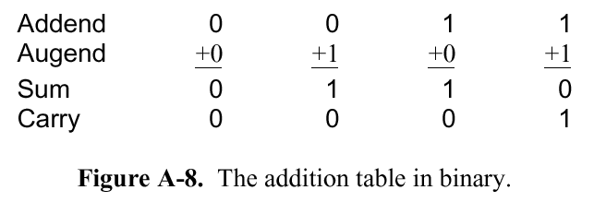
Addition In Different Number Bases
Method 2: By using an extended addition table
Extending the power table to 3 variables:
Recommended for adding two binary numbers.
0 0 0 0
1
1
+1
1
1
Find 1 0010 0011₂ + 1101 1110 1111₂
Augend
Addend
1 0 0 1 0 0 0 1 1
1 1 0 1 1 1 1 0 1 1 1 1
1
1
1
0
1
0
0
1
1
0
1
0
1
0
1
1
Carry
Sum
+
1
0
1 1 1

Slide 24
Multiplication In Different Number Bases
Base 10 Multiplication Table
 | 0 | 1 | 2 | 3 | 4 | 5 | 6 | 7 | 8 | 9
0 | 0 | 0 | 0 | 0 | 0 | 0 | 0 | 0 | 0 | 0
1 | 0 | 1 | 2 | 3 | 4 | 5 | 6 | 7 | 8 | 9
2 | 0 | 2 | 4 | 6 | 8 | 10 | 12 | 14 | 16 | 18
3 | 0 | 3 | 6 | 9 | 12 | 15 | 18 | 21 | 24 | 27
4 | 0 | 4 | 8 | 12 | 16 | 20 | 24 | 28 | 32 | 36
5 | 0 | 5 | 10 | 15 | 20 | 25 | 30 | 35 | 40 | 45
6 | 0 | 6 | 12 | 18 | 24 | 30 | 36 | 42 | 48 | 54
7 | 0 | 7 | 14 | 21 | 28 | 35 | 42 | 49 | 56 | 63
8 | 0 | 8 | 16 | 24 | 32 | 40 | 48 | 56 | 64 | 72
9 | 0 | 9 | 18 | 27 | 36 | 45 | 54 | 63 | 72 | 81
Provides the result of multiplying two single digit numbers
Example: 3₁₀ x 6₁₀ = 18₁₀
Product of multiple digits will be handled later.

Slide 25
Multiplication In Different Number Bases
Base 8 Multiplication Table
 | 0 | 1 | 2 | 3 | 4 | 5 | 6 | 7
0 | 0 | 0 | 0 | 0 | 0 | 0 | 0 | 0
1 | 0 | 1 | 2 | 3 | 4 | 5 | 6 | 7
2 | 0 | 2 | 4 | 6 | 10 | 12 | 14 | 16
3 | 0 | 3 | 6 | 11 | 14 | 17 | 22 | 25
4 | 0 | 4 | 10 | 14 | 20 | 24 | 30 | 34
5 | 0 | 5 | 12 | 17 | 24 | 31 | 36 | 43
6 | 0 | 6 | 14 | 22 | 30 | 36 | 44 | 52
7 | 0 | 7 | 16 | 25 | 34 | 43 | 52 | 61
Base 2 Multiplication Table
 | 0 | 1
0 | 0 | 0
1 | 0 | 1
1₂ x 1₂ = 1₂
(no digit 8 or 9, of course)
3₈ x 6₈ = 22₈ equivalent to 3₁₀ x 6₁₀ = 18₁₀

Slide 26
Multiplication In Different Number Bases
Base 16 Multiplication table
 | 0 | 1 | 2 | 3 | 4 | 5 | 6 | 7 | 8 | 9 | A | B | C | D | E | F
0 | 0 | 0 | 0 | 0 | 0 | 0 | 0 | 0 | 0 | 0 | 0 | 0 | 0 | 0 | 0 | 0
1 | 0 | 1 | 2 | 3 | 4 | 5 | 6 | 7 | 8 | 9 | A | B | C | D | E | F
2 | 0 | 2 | 4 | 6 | 8 | A | C | E | 10 | 12 | 14 | 16 | 18 | 1A | 1C | 1E
3 | 0 | 3 | 6 | 9 | C | F | 12 | 15 | 18 | 1B | 1E | 21 | 24 | 27 | 2A | 2D
4 | 0 | 4 | 8 | C | 10 | 14 | 18 | 1C | 20 | 24 | 28 | 2C | 30 | 34 | 38 | 3C
5 | 0 | 5 | A | F | 14 | 19 | 1E | 23 | 28 | 2D | 32 | 37 | 3C | 41 | 46 | 4B
6 | 0 | 6 | C | 12 | 18 | 1E | 24 | 2A | 30 | 36 | 3C | 42 | 48 | 4E | 54 | 5A
7 | 0 | 7 | E | 15 | 1C | 23 | 2A | 31 | 38 | 3F | 46 | 4D | 54 | 5B | 62 | 69
8 | 0 | 8 | 10 | 18 | 20 | 28 | 30 | 38 | 40 | 48 | 50 | 58 | 60 | 68 | 70 | 78
9 | 0 | 9 | 12 | 1B | 24 | 2D | 36 | 3F | 48 | 51 | 5A | 63 | 6C | 75 | 7E | 87
A | 0 | A | 14 | 1E | 28 | 32 | 3C | 46 | 50 | 5A | 64 | 6E | 78 | 82 | 8C | 96
B | 0 | B | 16 | 21 | 2C | 37 | 42 | 4D | 58 | 63 | 6E | 79 | 84 | 8F | 9A | A5
C | 0 | C | 18 | 24 | 30 | 3C | 48 | 54 | 60 | 6C | 78 | 84 | 90 | 9C | A8 | B4
D | 0 | D | 1A | 27 | 34 | 41 | 4E | 5B | 68 | 75 | 82 | 8F | 9C | A9 | B6 | C3
E | 0 | E | 1C | 2A | 38 | 46 | 54 | 62 | 70 | 7E | 8C | 9A | A8 | B6 | C4 | D2
F | 0 | F | 1E | 2D | 3C | 4B | 5A | 69 | 78 | 87 | 96 | A5 | B4 | C3 | D2 | E1
E₁₆ x D₁₆ = B6₁₆ (14₁₀x13₁₀ = 182₁₀)

Slide 27
Multiplication In Different Number Bases
Find the product of two hex integers 123 and DEF
Step 1: Break down the second multiplier into single digits
123 x DEF = 123 x (D00 + E0 + F)
= (123 x D) x 100 + (123 x E) x 10+ (123 x F) x 1
Step 2: Find the product in parenthesis individually
Step 3: Sum up the individual products
123xDEF = EC7 x 100 + FEA x 10 + 110D
= EC700 + FEA0 + 110D = FD6AD
1 2 3
X D
2 7
1 A
D
E C 7
1 2 3
X E
2 A
1 C
E
F E A
1 2 3
X F
2 D
1 E
F
1 1 0 D

Slide 28
Multiplication In Different Number Bases
Example: Find the product of two hex integers 123 and DEF
The three steps can be simplified into a single step as follows
1 2 3 Multiplicand
X D E F Multiplier
1 1 0 D (123xF)
F E A (123xE)
E C 7 (123xD)
F D 6 A D

Slide 29
Multiplication In Different Number Bases
Example: Find the product of two binary 1101 x 101
 |  |  | 1 | 1 | 0 | 1
 |  |  |  | 1 | 0 | 1
 |  |  | 1 | 1 | 0 | 1 | Position 0 (1st digit)
 |  |  | 0 | 0 | 0 |  | Position 1 (2nd digit)
 | 1 | 1 | 0 | 1 |  |  | Position 2 (3rd digit, first operand shifted by 2 bits)
1 | 0 | 0 | 0 | 0 | 0 | 1 | Add
redundant

Slide 30
Subtraction In Different Number Bases
Similar to Base 10. However a borrow is required from its immediate left digit, the base value is borrowed.
Example: 1100 1011₂ – 0110 1110₂
Equals to 2 in Base 10
Borrow |  | 0 | 10 0 | 01 10 | 01 10 |  | 10 0 | 2
Minuend |  | 1 | 1 | 0 | 0 |  | 1 | 0 | 1 | 1
Subtrahend | - | 0 | 1 | 1 | 0 |  | 1 | 1 | 1 | 0
Result |  | 0 | 1 | 0 | 1 |  | 1 | 1 | 0 | 1
Notes: Borrow, Minuend, Subtrahend and Result are expressed in the corresponding base (Base 2 in this example)

Slide 31
Subtraction In Different Number Bases
Example: 10 1101₂ – 01 1010₂
Example: 5475₈ – 3764₈
Minuend |  | 1 | 0 | 1 | 1 |  | 0 | 1
Subtrahend | - | 0 | 1 | 1 | 0 |  | 1 | 0
 |  | 0 | 1 | 0 | 0 |  | 1 | 1
Equals to 12 in Base 10
Borrow |  | 4 | 14
Minuend |  | 5 | 4 | 7 | 5
Subtrahend | - | 3 | 7 | 6 | 4
 |  | 1 | 5 | 1 | 1

Slide 32
Subtraction In Different Number Bases
Example: 245D₁₆ – 15FC₁₆
Equals to 19 in Base 10
Equals to 21 in Base 10
Borrow |  | 1 | 13 3 | 15
Minuend |  | 2 | 4 | 5 | D
Subtrahend | - | 1 | 5 | F | C
 |  |  | E | 6 | 1

Slide 33
Division In Different Number Bases
Division of Z / Y where Z is the dividend and Y is the divisor
Steps are similar to Base 10:
  Align the divisor (Y) with the most significant end of Z. Let the portion of the dividend to its bit aligned with the LSB of the divisor be denoted as X.
  Compare X and Y.
    If X ≥ Y, the quotient digit is ⎣X/Y⎦ and perform X – Y.
    If X < Y, the quotient digit is 0
  Shift Y by ONE bit to the right and go to step 2.

Slide 34
Division In Different Number Bases
Example: 110101₂ / 111₂
 |  |  |  |  | 0 | 1 | 1 | 1 |  | Quotient
1 | 1 | 1 | 1 | 1 | 0 | 1 | 0 | 1
 |  |  | 0 | 0 | 0
 |  |  | 1 | 1 | 0 | 1
 |  |  |  | 1 | 1 | 1
 |  |  |  | 1 | 1 | 0 | 0
 |  |  |  |  | 1 | 1 | 1
 |  |  |  |  | 1 | 0 | 1 | 1
 |  |  |  |  |  | 1 | 1 | 1
 |  |  |  |  |  | 1 | 0 | 0 |  | remainder

Slide 35
Division In Different Number Bases
Example: 543₈ / 7₈
 |  |  | 0 | 6 | 2 |  | Quotient
 |  | 7 | 5 | 4 | 3
 |  |  | 0
 |  |  | 5 | 4
 |  |  | 5 | 2
 |  |  |  | 2 | 3
 |  |  |  | 1 | 6
 |  |  |  |  | 5 |  | Remainder

Slide 36
Division In Different Number Bases
Example: 1AF3₁₆ / E₁₆
 |  |  | 0 | 1 | E | C | Quotient
 |  | E | 1 | A | F | 3
 |  |  | 0
 |  |  | 1 | A
 |  |  | 0 | E
 |  |  |  | C | F
 |  |  |  | C | 4
 |  |  |  |  | B | 3
 |  |  |  |  | A | 8
 |  |  |  |  |  | B | Remainder

Slide 37
Review Question
Perform the following operation
1476₈ + 3554₈ (answer = 5252₈)
127₈ + 29₁₆
Find the following operation
1001101₂ x 100110₂
1E4A₁₆ x FA2₁₆ (answer = 1D980D4₁₆)
Find the product of two hexadecimal numbers 22₁₆ and 67₁₆

Slide 38
Review Question
Perform the following operation
540045₈ – 325654₈ (answer = 212171₈)
540045₁₆ – 325654₁₆ (answer = 21A9F1₁₆)

Slide 39
COMPUTATIONAL ARITHMETIC

Slide 40
Representation for Signed Integers
How do computer represent negative numbers (signed numbers) and real numbers?
Numbers can be represented as a combination of
  Value or magnitude
  Sign (plus or minus)
To handle negative numbers, the following systems are used for signed numbers:
  2’s-complement (most commonly used)
  1’s-complement
  Sign-and-magnitude
To handle real numbers
  Floating Points (float, double)

Slide 41
Sign and Magnitude (SM)
In daily usage, negative numbers are usually written by writing a minus sign in front.
  Example: - (12)₁₀ , -(1100)₂
In sign-and-magnitude representation, this sign is usually represented by a bit:
  0 represents + and 1 represents -
For example, a 4-bit number can have 1-bit sign and 3-bit magnitude.
  0010_{SM} represents 2 for S&M
  1010_{SM} represents -2 for S&M
Note that the same bit pattern (1010) have different value in SM and other representations
  1010_{SM} represents -2 for S&M but 6 for unsigned binary
magnitude
sign

Slide 42
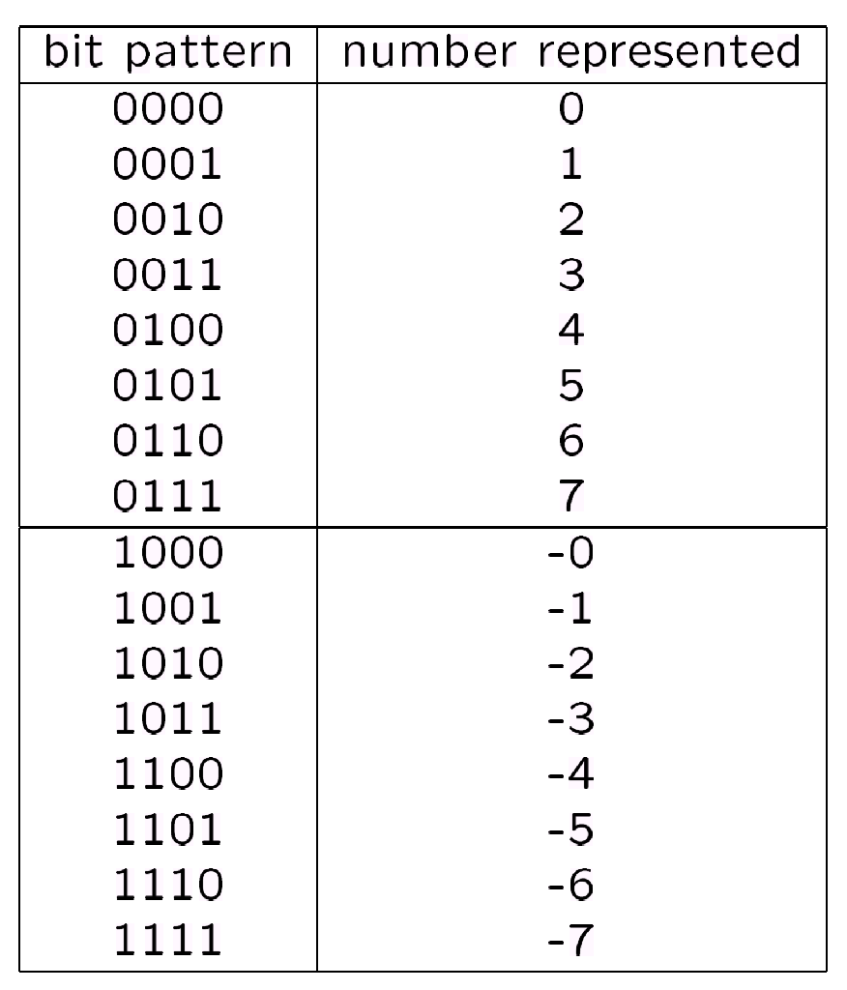
Sign and Magnitude (SM)
The range of an n-bit number ranges from
-(2^{(n-1)}-1) to +(2^{(n-1)}-1)
For example, the range of numbers represented by a 4-bit number in SM is from
Largest Positive Number:
0 111 = +(7)₁₀
Largest Negative Number:
1 111 = -(7)₁₀
Two zeroes:
0 000 = +(0)₁₀
1 000 = -(0)₁₀
All the numbers that can be represented by 4-bit binary number in SM

Slide 43
Sign and Magnitude (SM)
To negate a number, just invert the sign bit. For examples:
-0100001₂ = 1 0100001_{SM}
-0000101₂ = 0 0000101_{SM}
Difficulty in implementation: the actual methods of arithmetic used depends on the signs of the operands and the relative magnitudes of the inputs
4 + 2 vs 4 – 2 vs 12 - 4
Directly mimicking how human perform calculations does not makes a good machine due to the following reasons:
  Computer requires absolute definition of every possible condition. So, the algorithm must include every possibility
  Calculation algorithms are complex and difficult to implement in hardware

Slide 44
The Methods of Complement
The method of complements is a technique used to perform subtraction using only addition.
Commonly used in modern computer and calculators
In a complement method,
  The first digit of the number represents a positive/ negative number
  The positive numbers remain untouched.
  The negative numbers are converted into its complement version.
  To subtract/add two numbers, simply add the two numbers.
Examples:
  9’s Complement in Decimal and equivalently the 1’s Complement in Binary
  10’s Complement in Decimal and equivalently the 2’s Complement in Binary

Slide 45
9’s Decimal Complement
Assume a three digit decimal (Base 10) number. Split the decimal into half.
Positive numbers:
  0 to 499 are considered positive and they will represent itself
Negative numbers:
  To assign a value to the negative numbers, allow each digit to be subtracted from the largest numeral in the radix. In the case of decimal, the largest value numeral is the digit 9.
    -1₁₀ is represented as (9-0=9, 9-0=9, 9-1=8 → 998_{9s})
    -499₁₀ is represented as (9-4=5, 9-9=0, 9-9=0 → 500_{9s})
  Subtracting a value from some standard base value is known as taking the complement of the number.

Slide 46
9’s Decimal Complement
Numbers | Negative |  | Positive
Range of Decimal numbers | -499 | -000 | +0 | 499
Representation method | Complement |  | Number itself
Calculation | 999 minus number |  | none
9’s Representation | 500 | 999 | 0 | 499
– Increasing value +
How to determine if a number is positive/negative?
By looking at the first digit
0 through 4 → positive number
  5 through 9 → negative number
There are two ways to represent the value 0 in 9’s complement:
999_{9s} and 0_{9s}

Slide 47
9’s Decimal Complement
To convert a positive decimal number N into 9’s representation,
  N₁₀ is represented as N_{9s}
To convert a negative decimal number N into 9’s representation, we take its complement by subtracting a value from a standard basis value. Given a number N with n digits, its negation or -N when represented as 9’s complement is defined as:
-N₁₀ is represented as (10^{n}-1– N)_{9s}
To convert a positive 9’s representation number M (most significant digit <5) back to its decimal equivalent
M_{9s} is represented as M₁₀
To convert a negative 9’s representation number M (most significant digit >=5) M back to its decimal equivalent
M_{9s} is represented as -(10^{n}-1– M₉)₁₀ or
M_{9s} is represented as (M₉ - (10^{n-1}))₁₀

Slide 48
9’s Decimal Complement
Example: Convert the following decimal numbers into their 3 digits 9’s complement representation:
  459₁₀ = 459_{9s} (Positive number remains unchanged)
  -459₁₀ = (10³-1) – 459 = 999 – 459 = 540_{9s}
Example: Convert -36₁₀ into its 3 digits and 5 digits 9’s complement representation:
  -36₁₀ = (10²-1) – 36 = 99 – 36 = 63_{9s}
  -36₁₀ = (10⁵-1) – 36 = 99999 – 36 = 99963_{9s}
Example: Convert the following 9’s representation into their decimal value:
  459_{9s} = 459₁₀ (Positive number remains the same)
  540_{9s} = 540 - (10³-1) = 540 - 999 = -459₁₀

Slide 49
9’s Decimal Complement
Steps to perform Addition/subtraction in 9’s complement
Convert all the decimal operands into its 9’s complement equivalent
  If the #digits is specified, then extend the number of digits to the targeted number of digits
  For example, perform 119 – 20 in 4 digit, 9’s complement
  119₁₀ → 0119_{9s}
  -20₁₀ → 9979_{9s}
  If the #digits in the operation is not specified, then the number of digits follows the larger digits.
    For example, perform 119 – 20 in 9’s complement
  119₁₀ → 119_{9s}
  -20₁₀ → 979_{9s}

Slide 50
9’s Decimal Complement
Steps to perform Addition/subtraction in 9’s complement (cont…)
  If the #digits in the operation is outside of the supported range, then the operation cannot be performed
    For example, perform 919 – 20 in 3 digit, 9’s complement
    919₁₀ is out of range of a 3 digit, 9’s complement representation
2. Perform the addition with end-around carry.
For example, 273 – 18
Base 10
2 7 3
- 1 8
2 5 5₁₀
9’s complement
2 7 3
+ 9 8 1
1 2 5 4
1
2 5 5_{9s}

Slide 51
9’s Decimal Complement
Addition without an end-around carry
  Happens when the addition does not result in the changes in the sign.
  The addition in 9’s Complement does not cross the modulus (999 for a three digit 9’s complement representation)
NEGATIVE NUMBERS
POSITIVE NUMBERS
Base 10 |  |  | +250 |  |  |  |  | +250
 | -499 | -350 |  | -100 | -0 | 0 | 170 |  | 420 | 499
9’s Complement | 500 | 649 |  | 899 | 999 | 0 | 170 |  | 420 | 499
 |  |  | +250 |  |  |  |  | +250
In Base 10
In 9’s C
Both in Base 10 and 9’sC
-350 +250
-100
649 +250
899
170 +250
420

Slide 52
9’s Decimal Complement
Addition with end-around carry:
  The addition in 9’s C crosses the modulus
  Happens when the addition of a positive and a negative numbers generates a positive number.
  Add the carry digit to the result (ignore the carry digit)
Base 10 |  |  |  | +300
 | -499 | -200 | -000 |  | 0 | 100 | 499
9’s Complement | 500 | 799 | 999 |  | 0 | 100 | 499
 |  |  |  | +300
In Base 10
In 9’s C
-200 + 300
100
799 + 300
1 099
+1
100

Slide 53
9’s Decimal Complement
Subtraction
  9 – 10 is implemented in terms of addition of a positive and a negative number 9 + (-10)
  Count to the right (number of steps = 9’s complement of the number, e.g. 699 steps for -300) to subtract a number
  Subtraction will always generate a wraparound
 |  |  |  |  | -300
Base 10 | -499 | -000 | 0 | 200 | 499 | -499 | -100 | -000
9’s Complement | 500 | 999 | 0 | 200 | 499 | 500 | 899 | 999
 |  |  |  |  | +699
In Base 10
In 9’s C
200 -300
100
200 + 699
899

Slide 54
9’s Decimal Complement
Subtraction
 |  |  |  | -2
Base 10 | -499 | -199 | -000 | 0 | 499 | -499 | -201 | -000
9’s Complement | 500 | 800 | 999 | 0 | 499 | 500 | 897 | 999
 |  |  |  | +997
In Base 10
In 9’s C
-199 -2
-201
800 + 997
1 797
+1
798

Slide 55
Review Questions
Convert the following numbers into 9’s complement
362
-367
-177 (5 digits)
-479 (8 digits)
Add the 2 numbers below using the following method.
    41 – 25 (9’s complement)
    497 + 136 (9’s complement)
    998 – 13 (3 digits, 9’s complement)
    999 – 28 (5 digits, 9’s complement)

Slide 56
10’s Decimal Complement
Problem with 9’s complement:
  Two representations for a single value 0
  Extra operations when end-around carry is required
10’s complement:
  One single representation for a single value 0
  No end-around carry required. The carry digit is simply ignored.
Numbers | Negative |  | Positive
Range of decimal numbers | -500 | -001 | 0 | 499
Representation method | Complement |  | Number itself
Calculation | 1000 minus number |  | none
Representation example | 500 | 999 | 0 | 499

Slide 57
10’s Decimal Complement
Given a number N with n digits, its negation or -N when represented as 10’s complement is defined as:
9’s complement + 1 = (10^{n}-1) – N + 1 = 10^{n}-N
The positive number remains the same
Example: Find the 10’s complement of the following decimal numbers:
  459 = 459_{10c} = 459_{9s} (Positive number remains the same)
  -459 = 10³ – 459 = 1000 – 459 = (541)_{10c}
  -36 = 10² – 36 = 100 – 36 = (64)_{10c}
  -36 (Use 5 digits) = 10⁵ – 36 = 100000 – 36 = (99964)_{10c}
Example: Convert from 10’s complement back to decimal:
  (459)_{10s} = (459)₁₀ (Positive number remains the same)
  (541)_{10s} = 541- (10³) = 541- 1000 = -(459)₁₀

Slide 58
10’s Decimal Complement
Addition/subtraction in 10’s Decimal Complement
Example: 273₁₀ – 18₁₀
Convert all the decimal operands into its 10’s complement equivalent. The same rules for conversion as 9’s complement applies.
273 + (–018) → 273₁₀ = (273)_{9s}
018₁₀ ₌ (10³ - 018)_{10s} = (982)_{10s}
2. Perform the addition and ignore the carry digit
In Base 10
In 10’s
2 7 3
+ 9 8 2
1 2 5 5₁₀
2 7 3
+ 9 8 2
1 2 5 5 (ignore carry)
2 5 5_{10s}

Slide 59
Review Questions
Example 1: Get the 10’s complement of
247
-328
Example 2: Find 3 and 5 digits 10’s complement representation of -28
Example 3: Find the signed value of the 10’s complement representation 777.

Slide 60
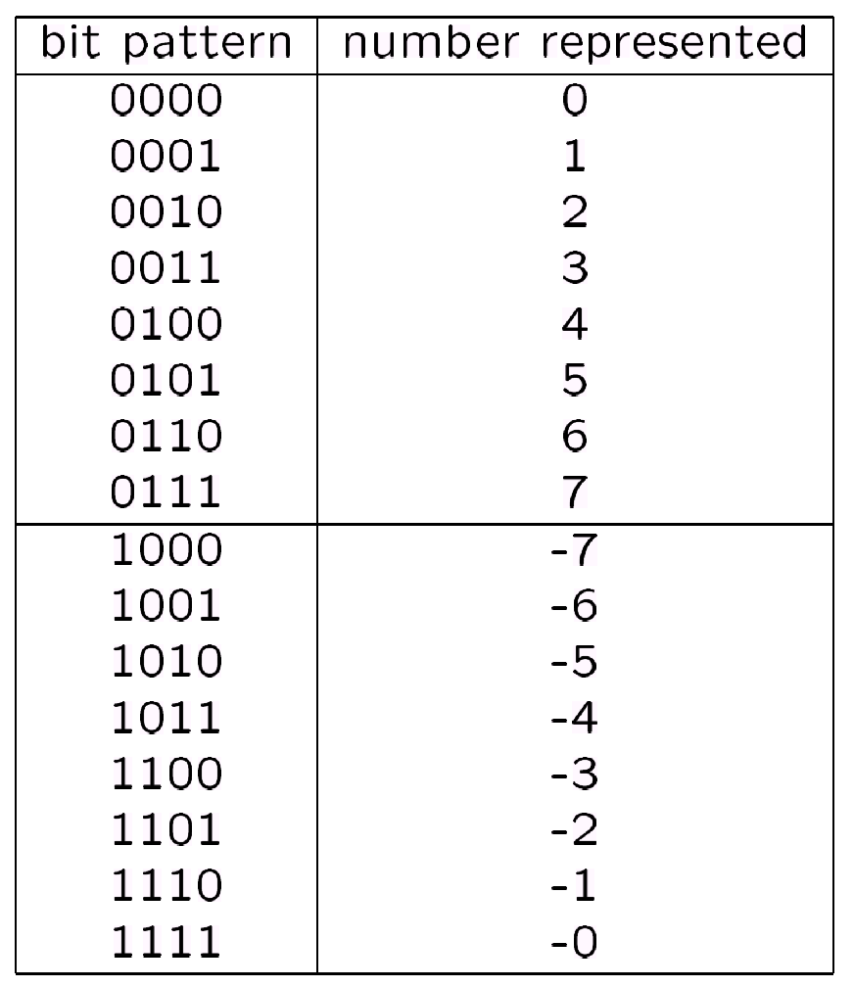
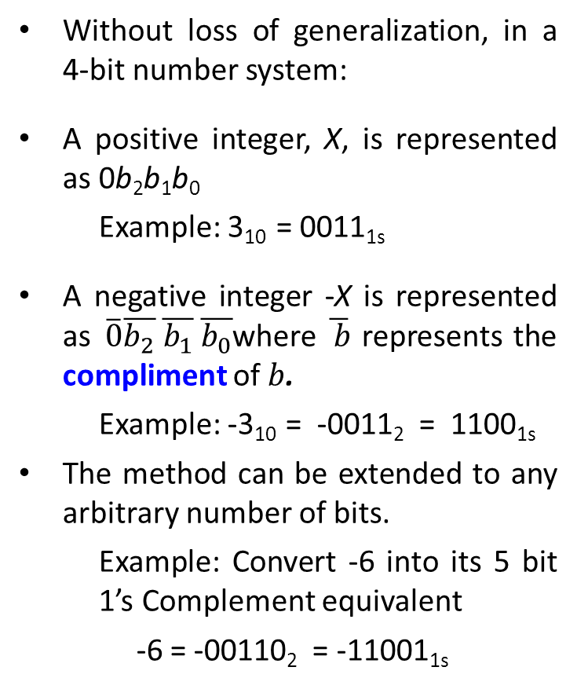
1’s Binary Complement
Without loss of generalization, in a 4-bit number system:
A positive integer, X, is represented as 0b₂b₁b₀
Example: 3₁₀ = 0011_{1s}
A negative integer -X is represented as$\overline{0}\overline{b_{2}} \overline{b_{1}} \overline{b_{0}}$where $\overline{ b}$ represents the compliment of $b$.
Example: -3₁₀ = -0011₂ = 1100_{1s}
The method can be extended to any arbitrary number of bits.
Example: Convert -6 into its 5 bit 1’s Complement equivalent
-6 = -00110₂ = -11001_{1s}
Figure: 1’s Complement of a 4 bit number

Slide 61
1’s Binary Complement
Note that the value of a 4 bit number in binary is not equivalent to actual value of the number in 1s Complement
  1000₂ is 8 in value but 1000_{1s} has a value of -7
Formally, the number represented -N has the bit pattern of (2^{n}-1)-N where n is the number of bit. Try compare with 9’s C.
  Example: When N = 6, -N or -6 is represented by the bit pattern (2⁴-1)-6 = 9 or 1001 in 1’s complement
The range that can be represented by n digits in 1’s complement is
-(2^{(n-1)}-1) to +(2^{(n-1)}-1)
  Example: The range of a 4 bit number is - (2³-1) to (2³-1)- 1 = -7 to 7

Slide 62
1’s Binary Complement
Examples (assuming 8-bit binary numbers):
(14)₁₀ = (00001110)₂ = (00001110)_{1s}
-(14)₁₀ = -(00001110)₂ = (11110001)_{1s}
-(80)₁₀ = -( ? )₂ = ( ? )_{1s}

Slide 63
1’s Binary Complement
Algorithm for addition, A + B:
Perform binary addition on the two numbers.
Perform end-around carry: if there is a carry out of the MSB, add 1 to the result.
Algorithm for subtraction, A – B:
A – B = A + (–B)
Take 1s complement of B by inverting all the bits.
Perform the addition operation as the steps per above

Slide 64
1’s Binary Complement
Examples: 4-bit binary system
+3 0011
+ +4 + 0100
---- -------
+7 0111
---- -------
+5 0101
+ -5 + 1010
---- -------
-0 1111
---- -------
-2 1101
+ -5 + 1010
---- ------
-7 10111
---- + 1
------
1000
- 1 1110
- 2 + 1101
---- ------
-3 11011
---- + 1
------
1100

Slide 65
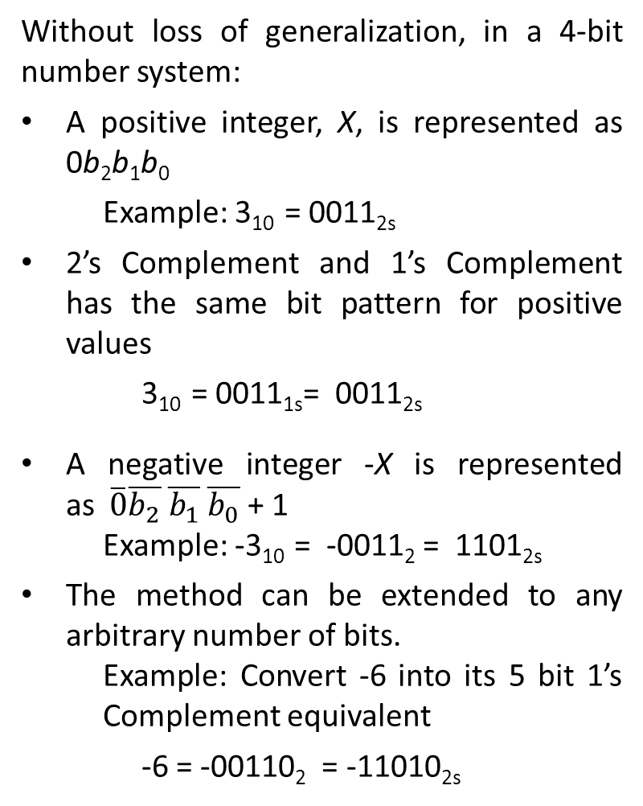
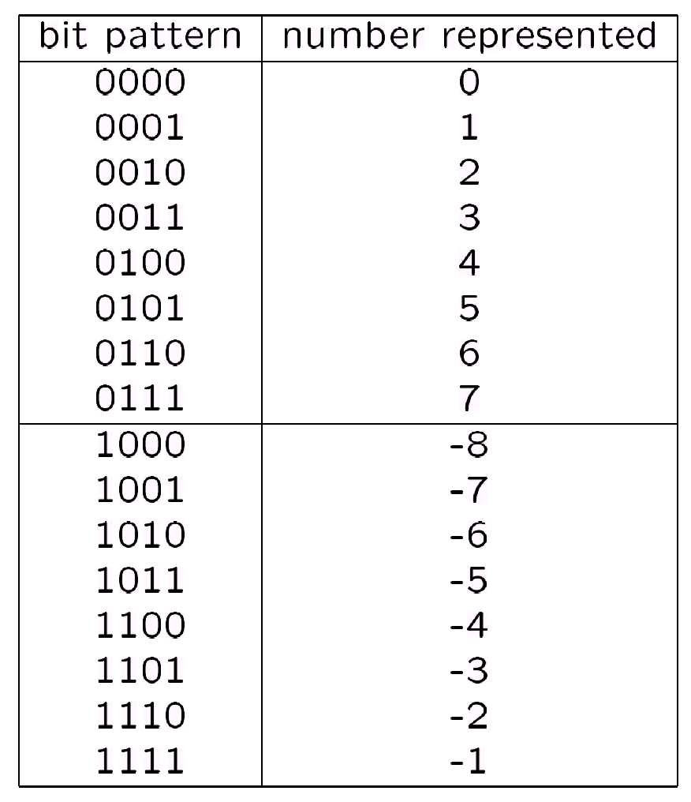
2’s Binary Complement
2’s Complement of a 4 bit number

Slide 66
2’s Binary Complement
As in previous method, the value of a 4 bit number in binary is not equivalent to actual value of the number in 1s Complement
  1000₂ is 8 in value but 1000_{2s} has a value of -8
Formally, the number represented -N has the bit pattern of 2^{n}-N where n is the number of bit.
  Example: when N = 6, -N or -6 is represented by the bit pattern 2⁴-6 = 10 or 1010_{2s} in 2’s complement
The range that can be represented by n digits in 1’s complement is
-2^{(n-1)} to +(2^{(n-1)}-1)
  Example: The range of a 4 bit number is -2³ to (2³-1)-1 = -8 to 7

Slide 67
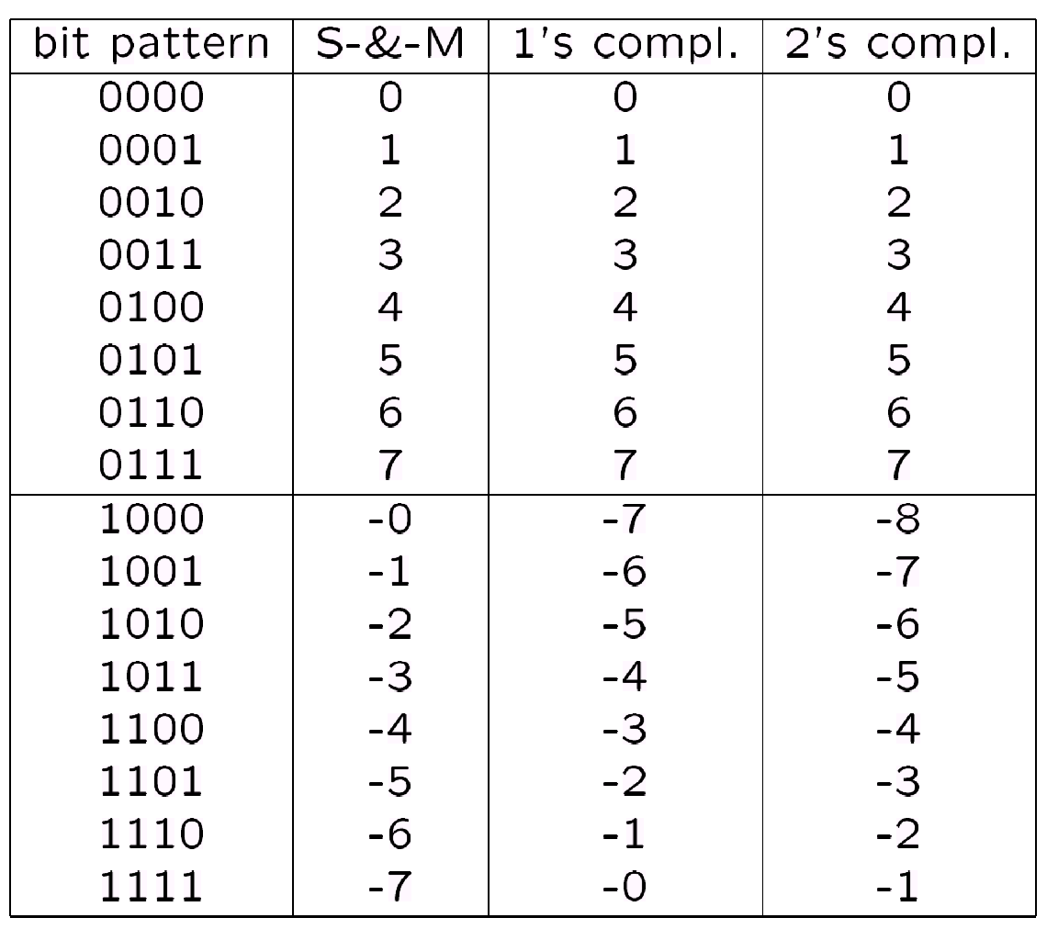
2’s Binary Complement
Sign-and-magnitude and 1st complement systems have -0 (redundant)
The 2's complement system does not have -0.
The 2’s complement system yields the most efficient logic circuit implementation (most often used in computers).
The positive numbers are the same for all systems

Slide 68
2’s Binary Complement
Algorithm for addition, A + B:
  Perform binary addition on the two numbers.
  Ignore the carry out of the MSB (most significant bit).
Algorithm for subtraction, A – B:
A – B = A + (–B)
  Take 2s complement of B by inverting all the bits and adding 1.
  Add the 2s complement of B to A.

Slide 69
2’s Binary Complement
Examples: 4-bit binary system
+3 0011
+ +4 + 0100
---- -------
+7 0111
---- -------
-2 1110
+ -6 + 1010
---- -------
-8 11000
---- -------
+6 0110
+ -3 + 1101
---- -------
+3 10011
---- -------
+4 0100
+ -7 + 1001
---- -------
-3 1101
---- -------

Slide 70
Carry and Overflow
Signed binary numbers are of a fixed range.
If the result of addition/subtraction goes beyond this range, overflow occurs.
In practice, we check the consistencies between sign bit to determine for overflow
  positive + positive gives negative → overflow
  negative + negative gives positive → overflow
  positive + negative will never cause overflow

Slide 71
Carry and Overflow
Examples: 4-bit numbers (in 2s complement)
Range of number is (1000)_{2s} to (0111)_{2s} or (-8₁₀ to 7₁₀)
(0101)_{2s} + (0110)_{2s} = (1011)_{2s}
(5)₁₀ + (6)₁₀ = -(5)₁₀ ?! (overflow!)
(1001)_{2s} + (1101)_{2s} = (10110)_{2s} discard end-carry
= (0110)_{2s} (overflow!)

Slide 72
Carry and Overflow
Check if overflow happens for the following arithmetic computation
Example 1:
  4 bit, 4 + 2
  Correct result
  No overflow, no carry
Example 2:
  4 bit, 4 + 6
  Incorrect result
  Overflow, no carry
0100 | = | (+ 4)
0010 | = | + (+ 2)
0110 | = | (+ 6)
0100 | = | (+ 4)
0110 | = | + (+ 6)
1010 | = | (– 6)

Slide 73
Carry and Overflow
Example 3:
  4 bit, -4 + -2
  Result correct ignoring the carry
  Carry but no overflow
Example 4:
  4 bit, -4 + -6
  Incorrect result
  Overflow, carry ignored
1100 | = | (– 4)
1110 | = | + (– 2)
11010 | = | (– 6)
1100 | = | (– 4)
1010 | = | + (– 6)
10110 | = | (+ 3)

Slide 74
Carry and Overflow
More examples: 4-bit binary system
Which of the above is/are overflow(s)?
Both (-9 and +11 is outside the range of a 4-bit binary 2nd complement system)
-3 1101
+ -6 + 1010
---- -------
-9 10111
---- -------
+5 0101
+ +6 + 0110
---- -------
+11 1011
---- -------

Slide 75
Review Question
Perform the following arithmetic operations with binary numbers (7 bits) and 2’s complement representation. Check if overflow happens
(+35) + (+40)
(-35) + (-40)
Perform the following arithmetic operations in 4 bits, 2’s complement. Check if there are any overflows.
-3 - 6
5 + 6

